Slide 1
HL ONLY!
TOPIC B2:
PROGRAMMING
LESSON B2-13
RECURSIVE ALGORITHMS

Slide 2
AGENDA
Warm Up Question
File Processing
Opening the File
Reading the File
Writing the File
File Availability
NOTE!
Have a way to take notes and a way to write code available for this lesson

Slide 3

THE WARM UP QUESTION
Do your best to, from memory, recreate the selection sort algorithm
You may reference the previous lessons if you get stuck

Slide 4
THE WARM UP ANSWER
nums = [4, 56, 88, 9, 44, 12, 23, 66, 0, -5, 36] for i in range(len(nums)-1): min = i for j in range(i+1, len(nums)): if nums[j] < nums[min]: min = j temp = nums[i] nums[i] = nums[min] nums[min] = temp print(nums)

Slide 5

FILE PROCESSING
File processing gives us the ability to store data permanently
This way, if you turn off the program or computer, the data can be recovered
The files that we often use for this can be text files (.txt), comma-separated value files (.csv), and binary files (.dat)
FILE

Slide 6
FILE PROCESSING
The location of the file should generally be in the same location as your program for convenience
This allows us to access the file via it’s relative path (using just the file name), such as PA 2-2.py
Otherwise, we must use it’s absolute path, which looks like this:
C:\Users\MichaelHill\OneDrive - Alcuin School\Desktop\GoodsNX\MYP\Programming Assignments\PA 2-2.py

Slide 7
FILE PROCESSING
Text files are sequential, meaning that we read them line by line
If we are writing to a text file, then we write to them line by line

Slide 8
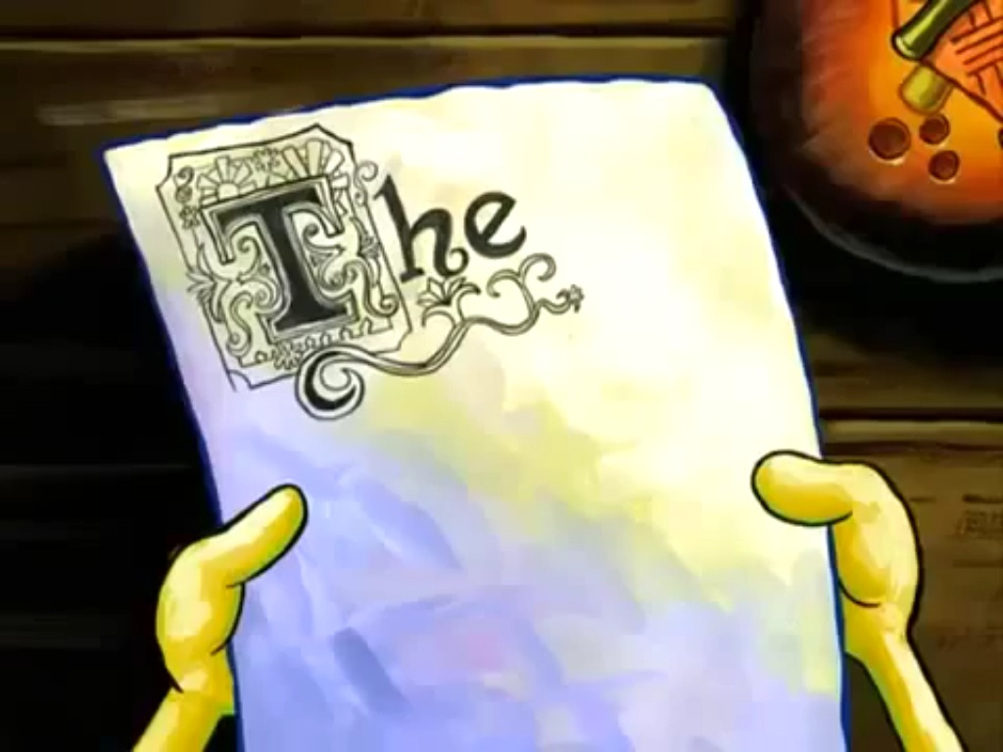
FILE WRITING
To write to a file, we have to follow four main steps:
1. Open the file to write to or append as needed
2. Prepare the line of text to be written
3. Write the line to the file
4. Close the file

Slide 9

FILE READING
To read from a file, here are the steps
Open the file to be read
Read the content of the file
There are multiple ways to do this
You can read one line at a time
Use a loop to read and process all lines
Store all lines into a data structure like a list
Close the file

Slide 10
OPENING THE FILE
To open a file in Python, use the code on the right
We want to write to this file, so we specify that we want to make a variable that has our open file
f = open(“text.txt”, “r”)
“w” designates that our file is open in write mode
If the file we try to write to doesn’t exist, it will make one
f = open("test.txt", “w")

Slide 11
WRITING THE FILE
Now, to write to the file, we call the write function on the variable
f.write(“First Line of Data”)
We then need to close the file to tell the program we’re done using it
f.close( )
If you try to write to write to a file with text already there it will ERASE IT
f = open("test.txt", “w") f.write("First Line!") f.close()

Slide 12
READING THE FILE
Even if the file has had multiple lines of input, .read( ) will get all of it and put it into a single string
f = open("test.txt", "w") f.write("First Line!\n") f.write("Second Line!\n") f.close() f = open("test.txt", "r") print(f.read()) f.close()

Slide 13
READING THE FILE
In the event that we’d rather read just one line at a time of input, we can replace our .read() function with the .readLine() function
This can be called multiple times to get however many lines are in the file
f = open("test.txt", "w") f.write("First Line!\n") f.write("Second Line!\n") f.close() f = open("test.txt", "r") print(f.readLine()) f.close()

Slide 14
MAKING SURE
One other thing to note is that, because we’re dealing with files, and sometimes Windows is funky, we should try, except any accesses to files
If another program tries to access or modify the same file, this should stop ours from crashing
try: f = open("test.txt", "w") f.write("First Line!\n") f.write("Second Line!\n") f.close() f = open("test.txt", "r") print(f.read()) f.close() except: print("There was a problem")

Slide 15
LOOPING ON INPUT
try: f = open("test.txt", "w") f.write("Basinga") f.write("Shoot, spelled it wrong") f.write("Bazinja") f.write("OH COME ON") f.close() f = open("text.txt", "r") for line in f: print(line) except: print("There was a problem")
In a lot of cases, we don’t know how many lines a file has
If we loop on the file’s input, we can do different things with each line
There are a couple of ways to do this, but the best is using a for loop

Slide 16
LOOPING ON INPUT
try: f = open("test.txt", "w") f.write("Basinga\n") f.write("Shoot, spelled it wrong\n") f.write("Bazinja\n") f.write("OH COME ON\n") f.close() f = open("test.txt", "r") for line in f: print(line) f.close() except: print("There was a problem")
You’ll notice that this works similarly to the way that looping on a list does
The file variable becomes each line as it loops on the open file f
We can then parse this info or use it how we please as a string
Make sure to put a \n at the end of any write that you want to end it’s own line

Slide 17
FILE AVAILABILITY
import os if os.path.exists("test.txt"): print("the file exists") else: print("the file does NOT exist *weep*")
Python also provides us the option to check if a file exists before we try to get data from it for example
This acts as an alternative to using the try, except blocks in some cases
You have to import the os (operating system) library

Slide 18

VOCAB TO REMEMBER
File Processing
Relative Path
Absolute Path
Open
Read
Write
Close

Slide 19
LABBBBBB
Write a program that uses a file to stores the number of times that the program has been run
You’ll need to convert to integers
Write a program that gets 10 numbers of input and writes them into a file, one per line
Then, write a program that reads those numbers into a list and then prints the sorted version of that list

